Slide 1
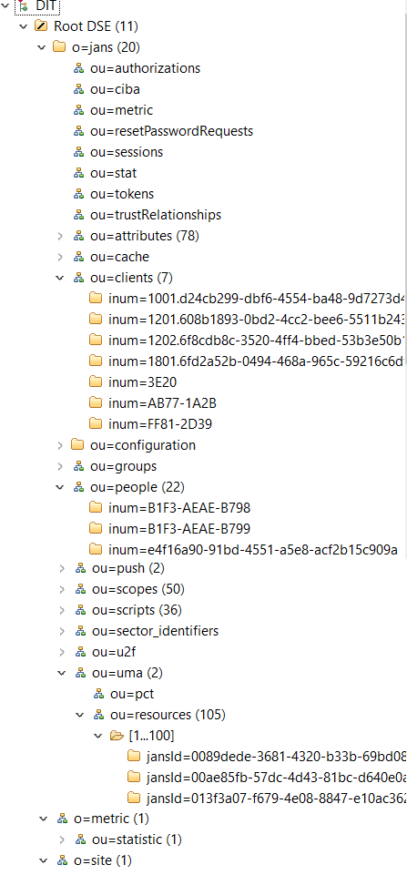
Convert object classes to tables
Table name = objectClass name
doc_id | e4f16a90-91bd-4551-a5e8-acf2b15c909a | Last RDN value | VARCHAR(48) Primary key, Not null, Unique
objectClass | jansPerson | Last objectClass | VARCHAR(48)
dn | inum=e4f16a90-91bd-4551-a5e8-acf2b15c909a,ou=people,o=jans | LDAP DN | VARCHAR(128)
attr1 (from OC) | attr1 value | Attribute value
attr2 (from OC) | attr2 value
…
Convert attributes based on these rules
Schema type | SQL Type
1.3.6.1.4.1.1466.115.121.1.7 | Boolean syntax | TINYINT
1.3.6.1.4.1.1466.115.121.1.12 | Distinguished name syntax | TINYTEXT
1.3.6.1.4.1.1466.115.121.1.15 | Directory string syntax | VARCHAR(127) / TINYTEXT / TEXT / Type from schema if defined
1.3.6.1.4.1.1466.115.121.1.24 | Generalized Time syntax | DATETIME(3)
1.3.6.1.4.1.1466.115.121.1.27 | Integer syntax | INT
Each type above with multivalued=true | json | Store values as JSON types in JSON array

Slide 2
Extended rules to specify required type
{
"desc": "jans user id",
"equality": "caseIgnoreMatch",
"names": [
"jansUsrId",
"usrId"
],
"oid": "jansAttr",
"substr": "caseIgnoreSubstringsMatch",
"syntax": "1.3.6.1.4.1.1466.115.121.1.15",
"x_origin": "Jans created attribute“,
“db_data_type": {“db” : “mysql”, “type” : “VARCHAR”, “size” : 47}
},
Extended rules to convert Directory Strings
Default string size is 47.
Override string size with size from “db_data_type” if exists.
Use VARCHAR(size) if length <= 127
Use TINYTEXT if 128 < length <= 255
Use TEXT if length > 255

Slide 3
Case when attribute defined in system schema
{
"names": [
“userPassword"
],
"syntax": "1.3.6.1.4.1.1466.115.121.1.15",
"x_origin": "Jans created attribute“,
“db_data_type": {“db” : “mysql”, “type” : “VARCHAR”, “size” : 63}
},

Slide 4
JSON attributes
In order to avoid MySQL limitation:
Error Code: 1235. This version of MySQL doesn't yet support 'CAST-ing JSON OBJECT type to array' 0.047 sec
SQL ORM stores data in JSON in next format instead of storing them as JSON array:
'{"v": [94582,94536]}’
'{"v": [2021-02-01T21:18:28.382, 2021-03-01T21:18:28.382]}’
'{"v": [“value_1", “value_2"]}'

Slide 5
JSON indexes
This index will be used to check if array contains specific value
ALTER TABLE jans.jansPerson ADD INDEX jansExtUidValues( (CAST(jansExtUid->’$.v' AS UNSIGNED ARRAY)) );
ALTER TABLE jans.jansPerson ADD INDEX address( (CAST(address->'$.v' AS CHAR(48) ARRAY)) );
UNSIGNED/ CHAR(48) are used here as reference. Instead of it valid data type should be used.
Sample query:
SELECT COUNT(*) FROM jans.jansPerson doc
WHERE doc.objectClass = 'jansPerson' AND JSON_CONTAINS(doc. jansExtUid->'$.v', CAST(‘[243]' AS JSON))
This index is need to compare specific value from array
ALTER TABLE jans.jansPerson ADD INDEX jansExtUidValue0( (CAST(jansExtUid->’$.v[0]' AS UNSIGNED)) );
ALTER TABLE jans.jansPerson ADD INDEX jansExtUidValue1( (CAST(jansExtUid->’$.v[1]' AS UNSIGNED)) );
ALTER TABLE jans.jansPerson ADD INDEX jansExtUidValue2( (CAST(jansExtUid->’$.v[2]' AS UNSIGNED)) );
This index setup should create for first 3 elements of array only. Admin can add indexes for next elements later if needed.
Sample query:
SELECT COUNT(*) FROM jans.jansPerson doc
WHERE doc.objectClass = 'jansPerson' AND jansExtUid->’$.v[0]' > 3 or jansExtUid->’$.v[1]' > 3 or jansExtUid->’$.v[2]' > 3

